Slide 1

In-browser Inference with ONN Runtime Web
Emma Ning| Product Manager in Microsoft

Slide 2
In-browser Machine Learning
Enjoy the benefits
Cross-platform support
Privacy protection
Real-time Analysis
Easy Access and distribution

Slide 3
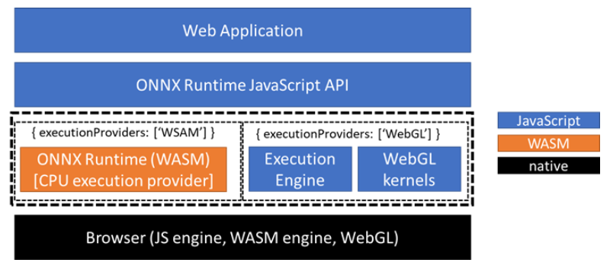
ONNX Runtime Web(ORT Web)
A new feature in ONNX Runtime to enable JavaScript developers to run and deploy machine learning models in browsers (replacing ONNX.js)
Optimize ONNX model inference on both CPUs and GPUs

Slide 4
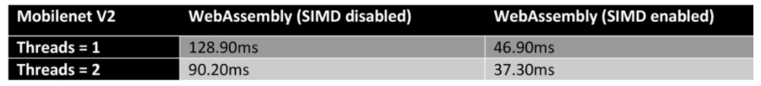
ONNX Runtime Web – WASM backend for CPU
Compile ONNX Runtime CPU engine into WebAssembly backend
Support most functionalities native ONNX Runtime offers
Enable multi-threading and SIMD in WebAssembly for perf acceleration
3.4x faster with two threads together with SIMD enabled

Slide 5
ONNX Runtime Web – WebGL backend for GPU
JavaScript based implementation with WebGL APIs
WebGL provides direct access to a computer’s GPU
Various optimizations including pack mode, cache, and graph fusion
E.g., reducing up to 75 percent memory footprint while improving parallelism with pack mode

Slide 6
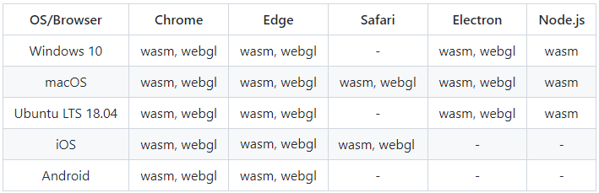
ONNX Runtime Web
Operator support
WASM backend - All ONNX operators are supported
WebGL backend - a subset of ONNX operators supported operators by each backend
Platform Compatibility

Slide 7
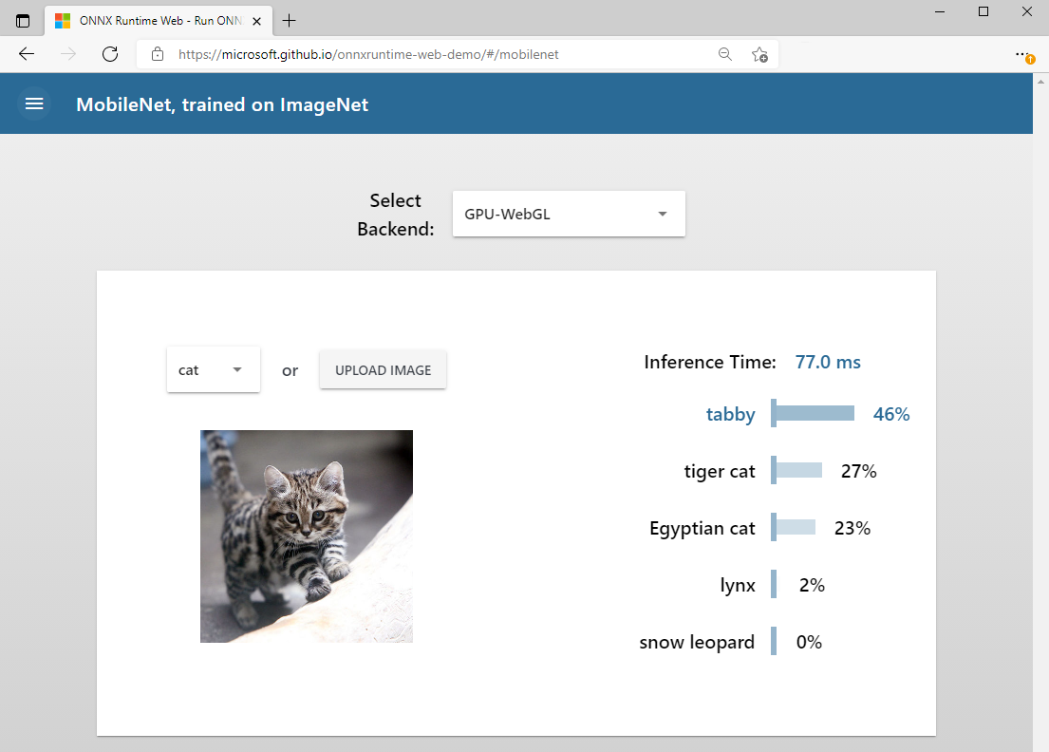
To use ONNX Runtime Web
ORT Web Demo
E2E tutorial
const ort = require('onnxruntime-web’);
// create an inference session, using WebGL backend. (default is 'wasm’)
const session = await ort.InferenceSession.create('./model.onnx', { executionProviders: ['webgl'] }); …
// feed inputs and run
const results = await session.run(feeds);

Slide 8
Looking forward
WebGL Backend Coverage Improvement
Performance improvement
More demos with more capabilities

Slide 9
Thanks

